Slide 1


DEPI Graduation Project Presentation – 2025
Rewan Khaled
Makarious Zaytoun
Ahmed EL-Banna
Mohammed Henna
Amany Ayman
Noha Mohammed

Slide 2
INTRODUCTION
Software testing plays a critical role in ensuring the quality and functionality of software systems — especially in e-commerce platforms where user experience and trust are essential.
Our goal
is to ensure the system is reliable and make it performs well under different conditions.

Slide 3
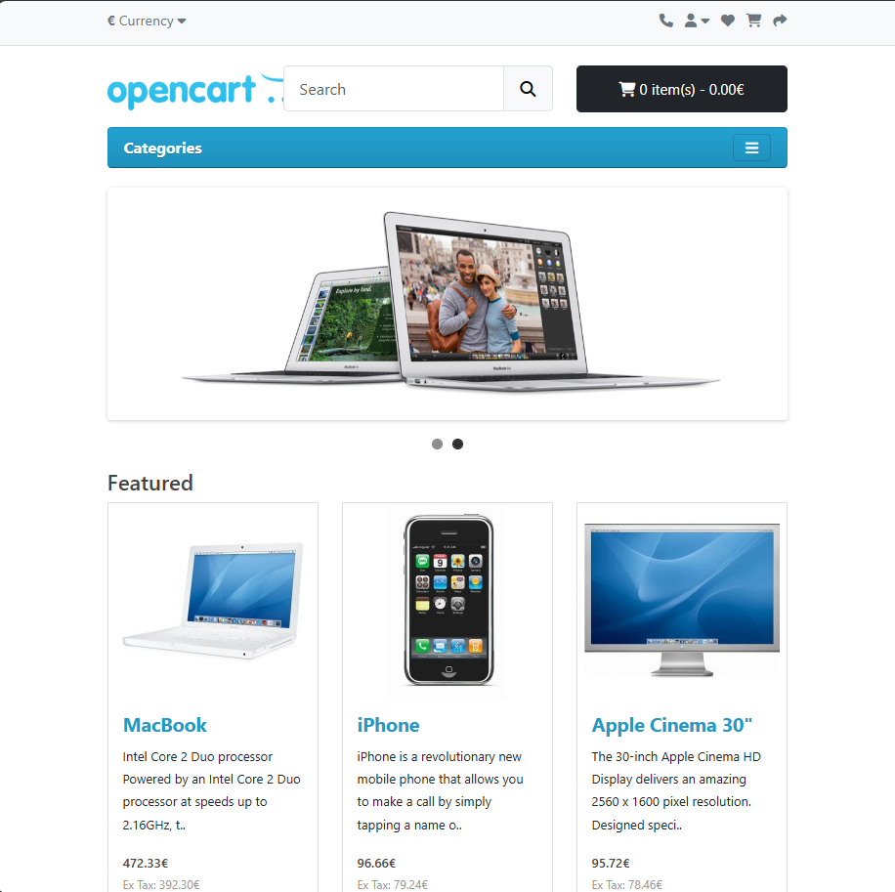
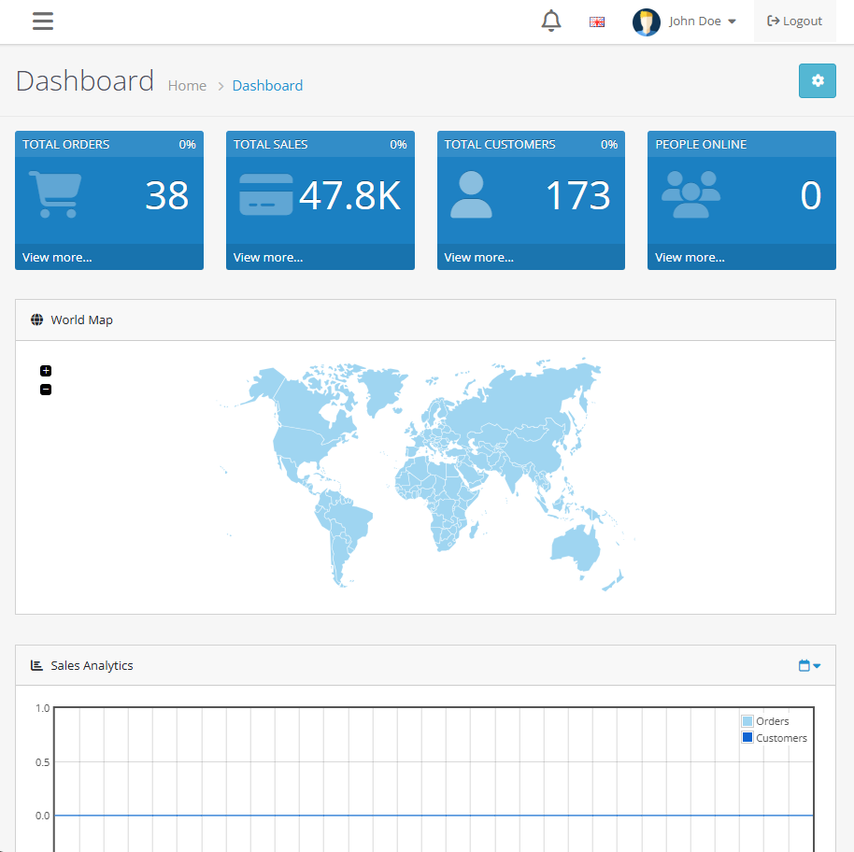
WHY OPEN CART?
User Frontend
Admin Panel
Browsing → Product Details → Cart → Checkout → Orders
Products Management , Orders Management , Reports

Slide 4
Agile Approach
Requirement Analysis
Test Execution
1
2
3
4
Test Case Design
Reporting

Slide 5
TYPES OF TESTING PERFORMED
Manual Testing
API Testing
Database Testing
Automation Testing

Slide 6









Tools & Technologies
Jira
Excel
Postman
MySQL Workbench
Java
Selenium
TestNG
Cucumber
GitHub

Slide 7
Test plan
Sprint 1
11 Oct - 17 Oct
Test Planning & Environment Setup
Sprint 2
18 Oct - 24 Oct
Sprint 3
Manual Functional Testing
25 Oct - 31 OctAPI Testing
Sprint 4
1 Nov - 7 Nov
Sprint 5
Database Testing
8 Nov - 21 Nov
Automation Testing
Sprint 6
22Nov - 28 Nov
Final Execution

Slide 8

Manual Testing
Manual Testing is the process of checking software manually to ensure it works correctly. The tester executes test cases step by step and compares the actual results with the expected results to find any bugs.
Key Points:
Performed by a human tester.
Uses predefined test cases and scenarios.
Ensures software quality before release.
Detects issues in functionality, UI, and performance

Slide 9
Importance of Manual Testing
Helps find real user issues
Identifies UI and UX problems
Helps testers understand
the system better
Required before automation testing
Finds issues that automation
cannot detect
Flexible and easy to update
Suitable for small and
medium projects
Reduces cost by finding bugs early

Slide 10
Manual Testing Steps
Understand Requirements
Bug Reporting
Create Test Plan
Re-Testing
Write Test Cases
Regression Testing
Prepare Test Environment
Test Report
Execute Test Cases

Slide 11
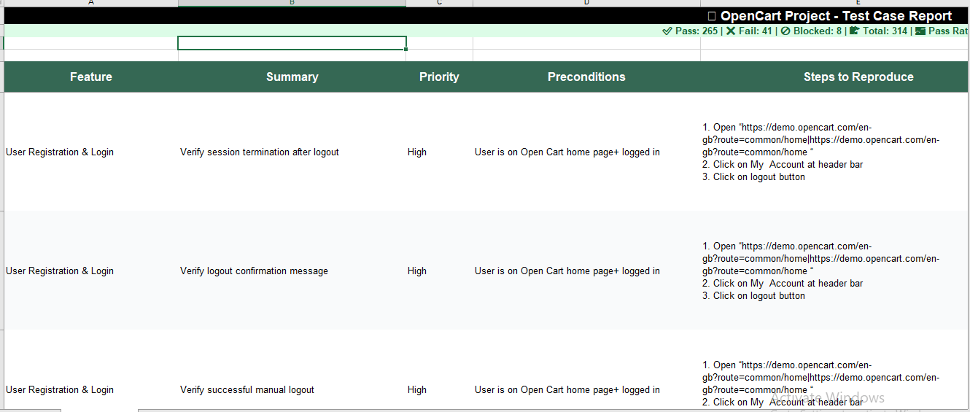

Slide 12
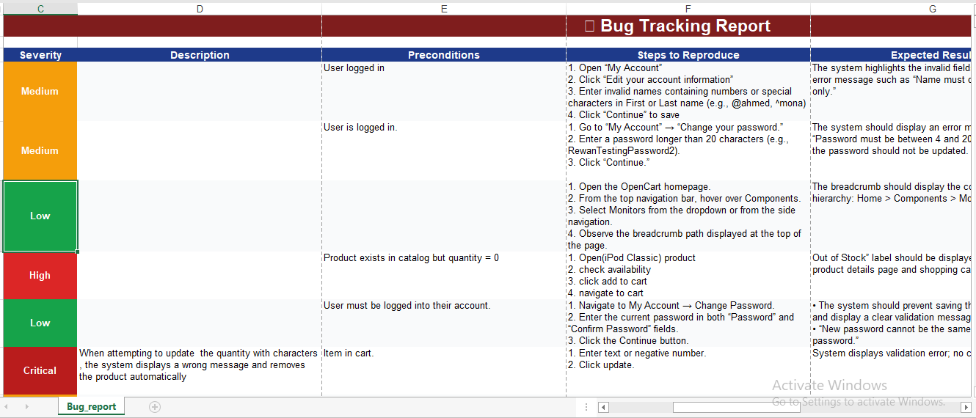

Slide 13
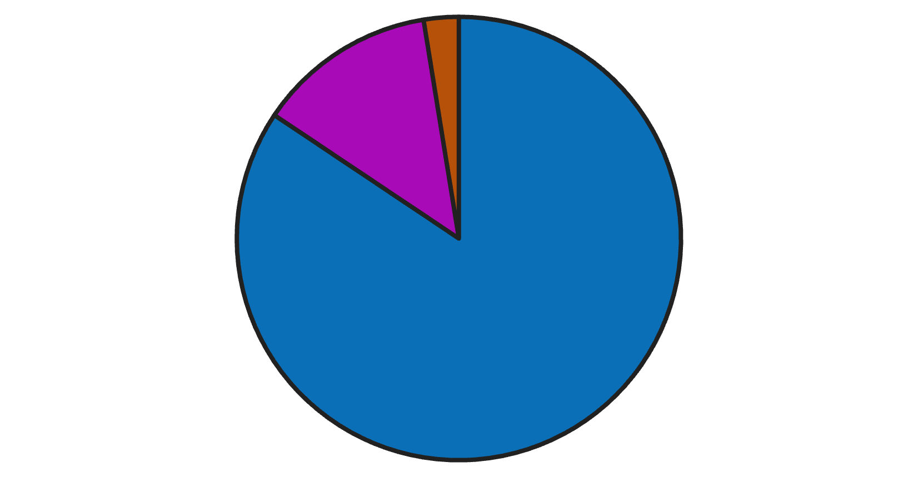
Manual Testing - Execution Summary
Our manual testing phase provided valuable insights into the OpenCart platform's stability and functionality, highlighting areas for improvement.
Key Metrics:
Passed: 265 test cases
Failed: 41 test cases
Blocked: 8 test cases
Passed
Failed
Blocked
Total Test Cases: 314
Pass Rate: 84%

Slide 14




Major Functional Defects
Cart update logic issues (quantity change removing items).
Item cancellation not reflected in Order History after submitting return request
Incorrect shipping cost calculation after selecting shipping method
Item marked in stock but unavailable at checkout

Slide 15
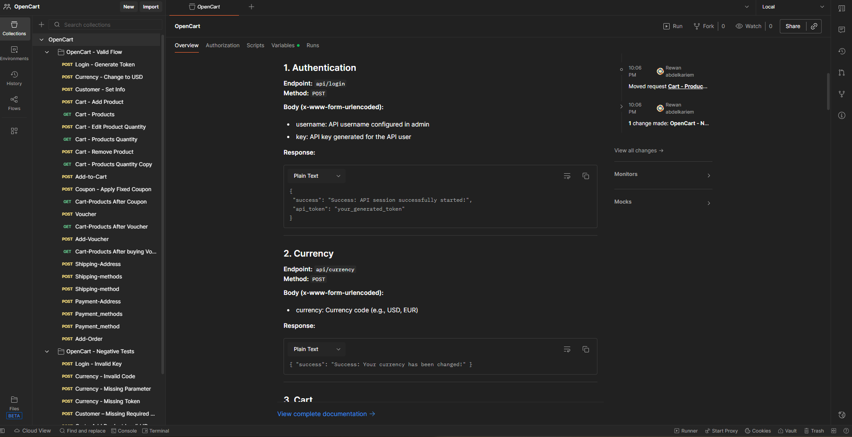
API Testing

Slide 16
API Testing - Validated endpoints:
Authentication → /api/login
Cart → /api/cart/add, /edit, /products
Currency → /api/currency
Coupons & Vouchers
Shipping & Payment
Order → /api/order/add

Slide 17
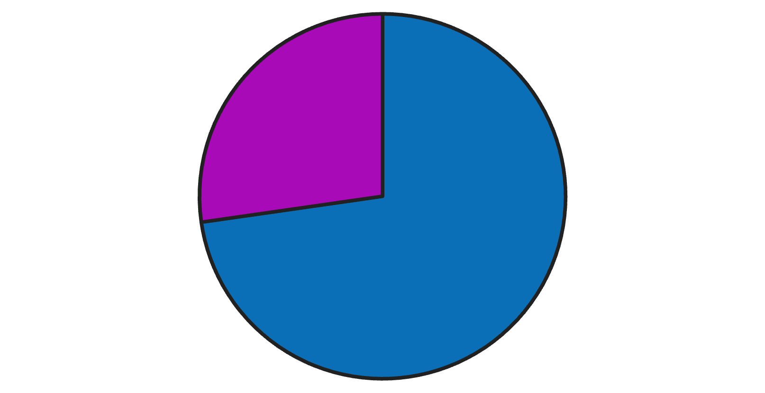
API Testing- Execution Summary
Key Metrics:
Passed: 24 test cases
Failed: 9 test cases
Passed
Failed
Blocked
Total Test Cases: 33
Pass Rate: 72.7%

Slide 18
Major issues
Lack of Documented Responses & Error Codes
Incomplete documentation for Order APIs.
Major Defects
200 OK returned for invalid or unauthorized requests.
Mixed HTML + JSON in error responses.
Missing validation errors on several endpoints.

Slide 19
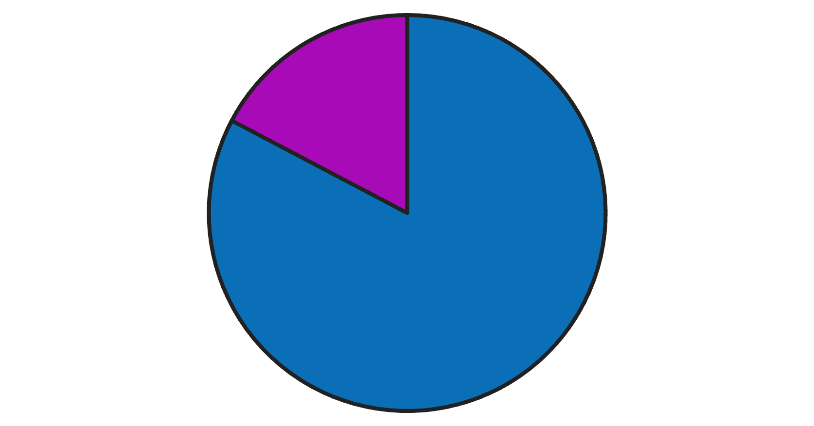
Database Testing- Execution Summary
CRUD validation across OpenCart core tables
Foreign Key checks for )Customers, Addresses) , (Orders, Order Products) , (Wishlist, Customers)
Key Metrics:
Passed: 91 test cases
Failed: 19 test cases
Passed
Failed
Blocked
Total Test Cases: 110
Pass Rate: 82.7%

Slide 20
Database Testing- Major Findings
1
System allows duplicate customer emails when updating a customer record
2
Cart item price stored as NULL in database while UI displays a valid price
3
Missed constraints on mandatory fields on databases (e.g., first name)

Slide 21
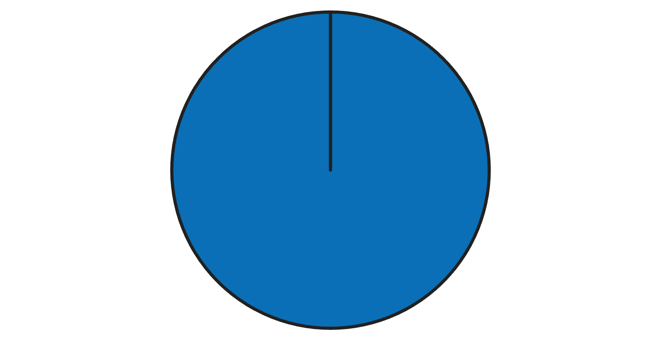
Automation Testing- Execution Summary
Key Metrics:
Passed: 52 test cases
Failed: 0 test cases
Passed
Failed
Blocked
Total Test Cases: 52
Pass Rate: 100%

Slide 22
Automation Testing - Automation Stack
Language: Java
Framework: Selenium WebDriver + TestNG
Design: Page Object Model (POM)
BDD: Gherkin + Cucumber
Report: Allure Report
Automated flows: Login, Search, Add to Cart, Checkout, admin flows

Slide 23
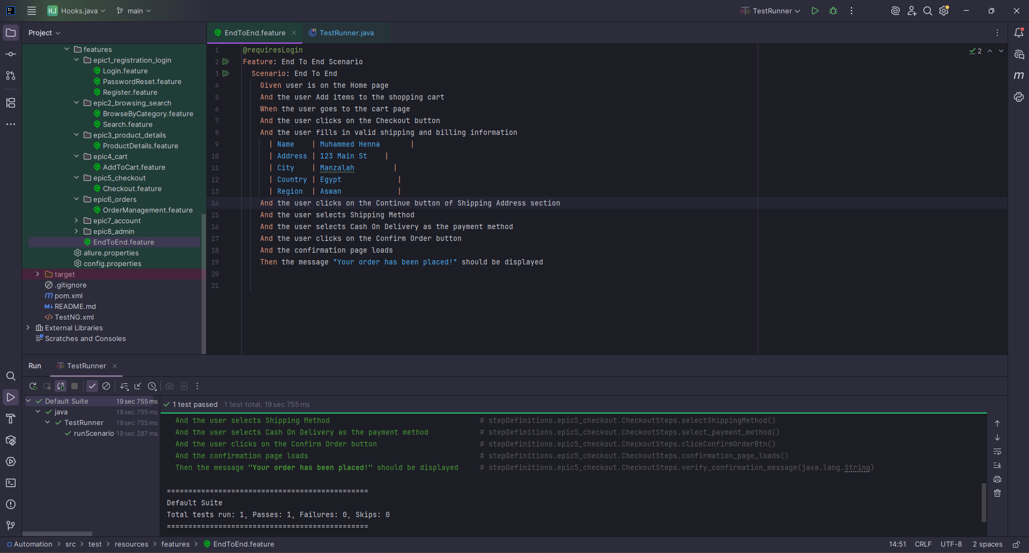
Sample BDD Scenario

Slide 24
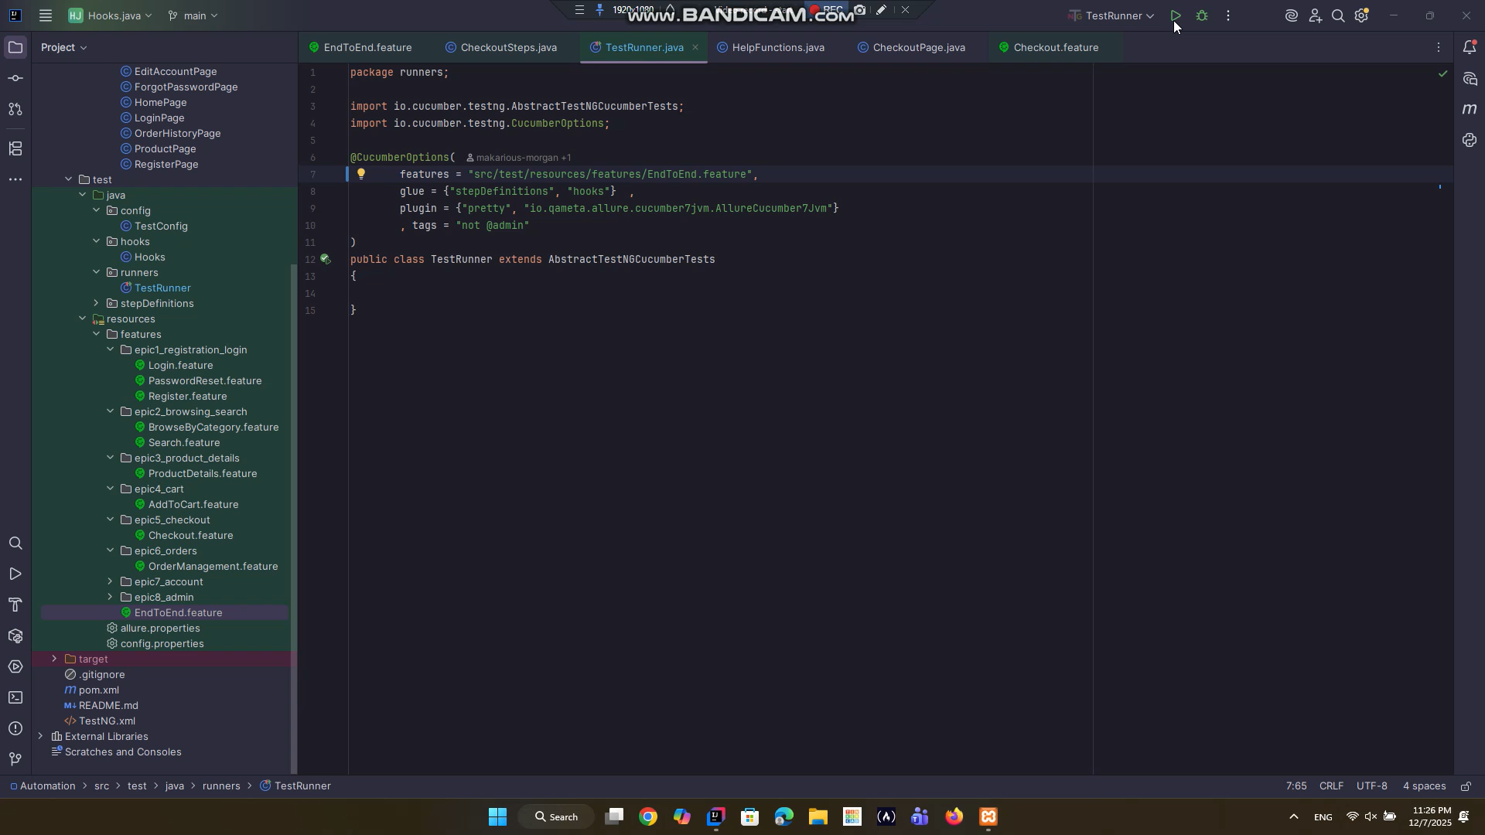

Slide 25
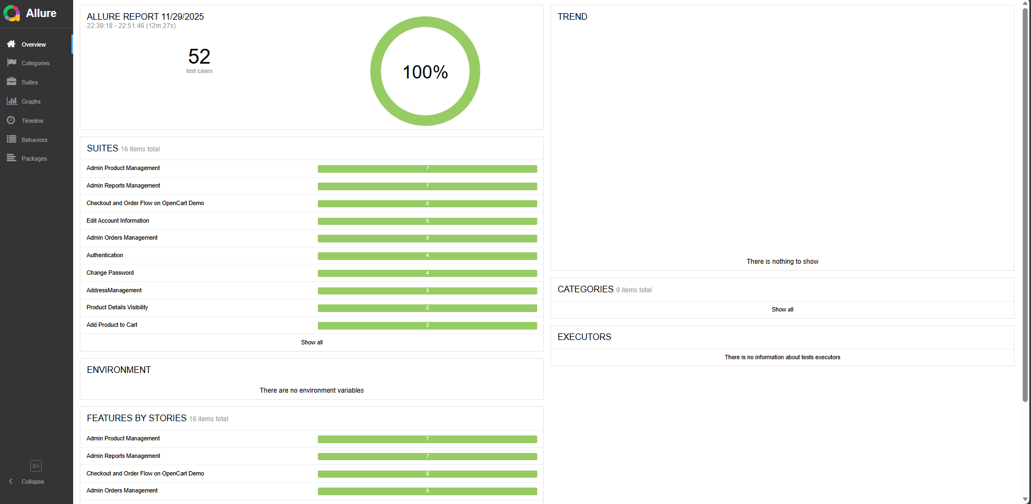

Automation Reporting

Slide 26

Performance Testing
We performed performance testing to measure how the OpenCart system behaves under different types of load.
Objectives
Identify system stability
Measure response time changes under pressure
Determine the breaking point of the server
Tools
Apache JMeter 5.6.3

Slide 27
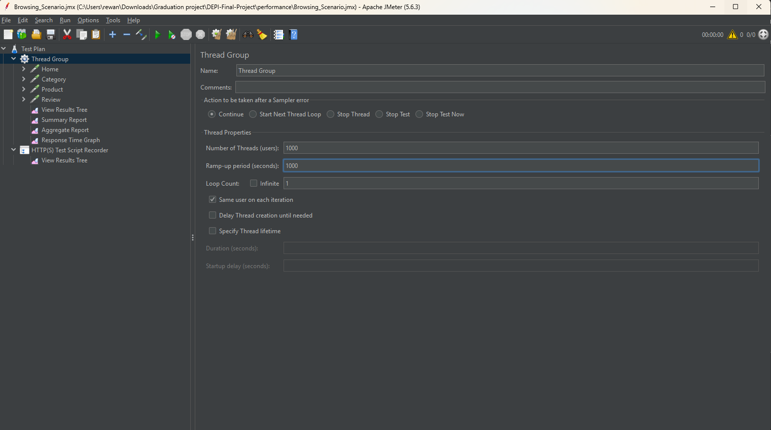
Performance Testing

Slide 28
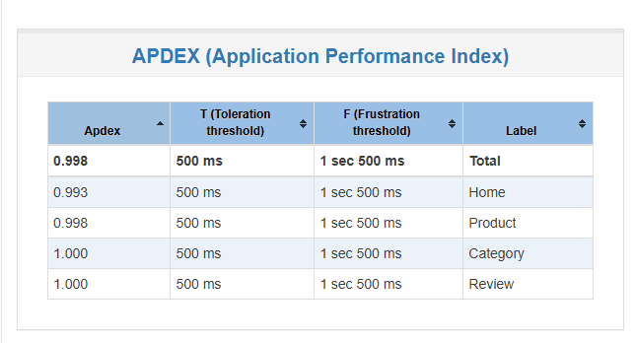
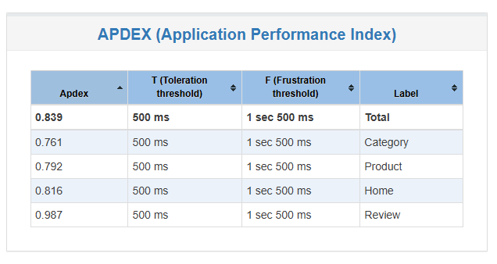

Performance Testing – Load Testing
100 users
1000 user
Summary • APDEX 0.998 • No errors • Excellent baseline performance
Summary: • APDEX 0.839 • No errors • Stable under expected load

Slide 29
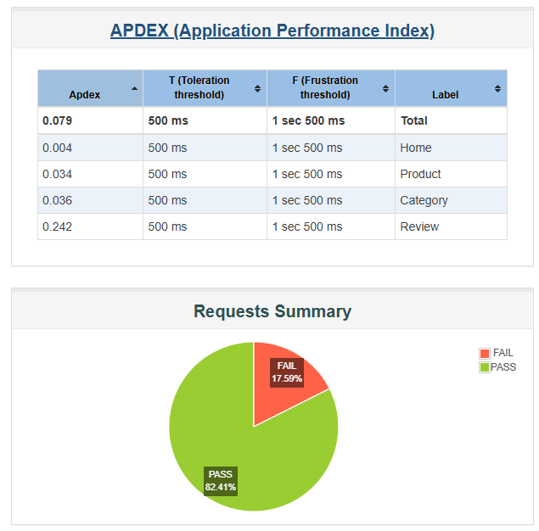

Performance Testing – Stress Testing
Summary:
Users: 4000, Ramp-up: 400 sec
APDEX Total = 0.079 → Very poor performance
Errors: 2815 / 16000 requests = 17.59%
Average Response Time ≈ 22.8 sec
Max Response Time ≈ 88 sec
Error Type: Connection Refused (server cannot accept more connections)

Slide 30
Challenges & Solutions
Challenges
Solutions
1
Missing Website Documentation
1
Performed exploratory analysis and created our own internal documentation for unclear flows
2
Human Verification Blocking Selenium Automation
2
Used a local OpenCart environment to bypass CAPTCHA and ensure stable automation
3
Different screen resolutions, which caused layout shifts and element position changes.
3
standardized browser window size across the team
4
Coordinated meeting times through shared availability slots and async communication
4
Scheduling & Collaboration Limitations
5
Added detailed logs, manually checked API responses, and documented all API issues
5
API Testing Challenges
6
Created our own API documentation to clarify missing or unclear endpoints

Slide 31

Documentation For Project
URL web site
https://www.opencart.com/index.php?route=cms/demo
URL test API postman
https://app.getpostman.com/join-team?invite_code=89e4f3c752dd7b11a0817c3d275a9c529294b8722f8a7bbb3d7a70af5b0450a7&target_code=15721fbafa50c5e2b6b620d43a5a83e4
URL Jira project
Summary - Opencart - Jira
URL Repo for GitHub Project
RewanAbdulkariem/DEPI-Final-Project

Slide 32
THANKS!
Do you have any questions?

